Slide 1
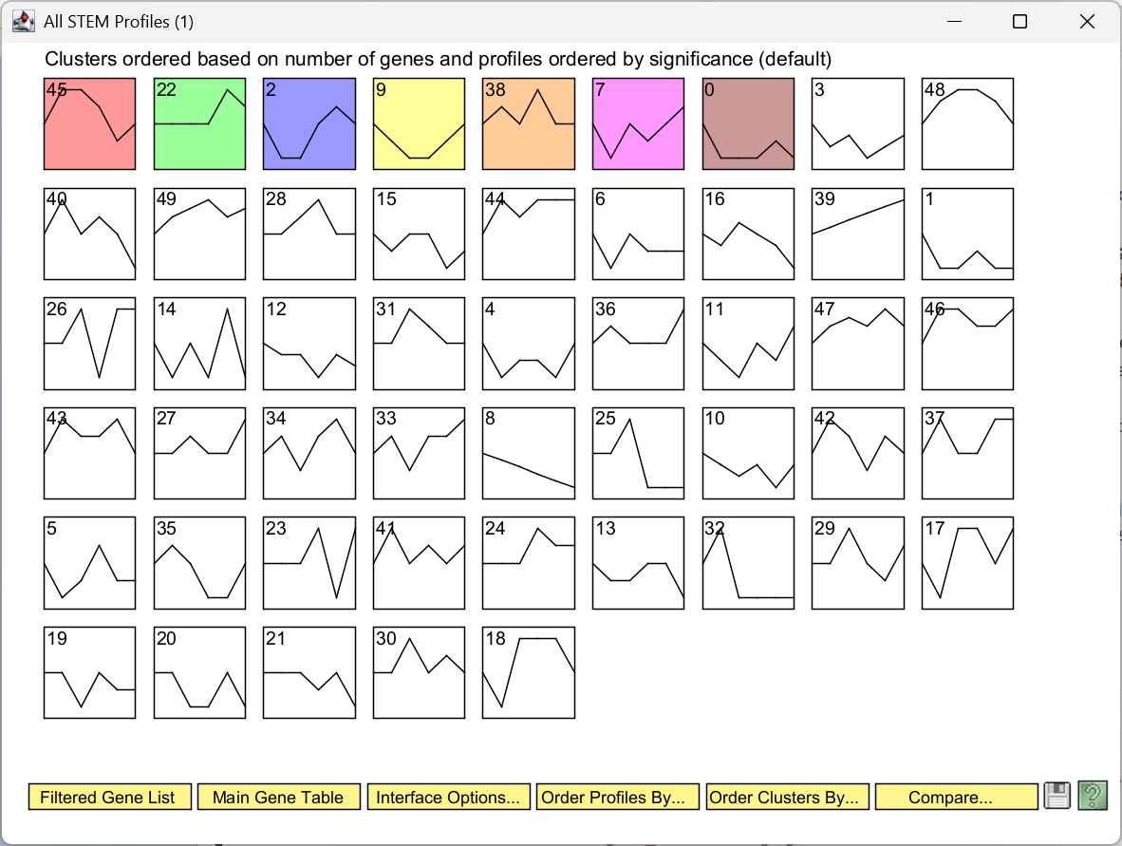
dCIN5 stem results

Slide 2
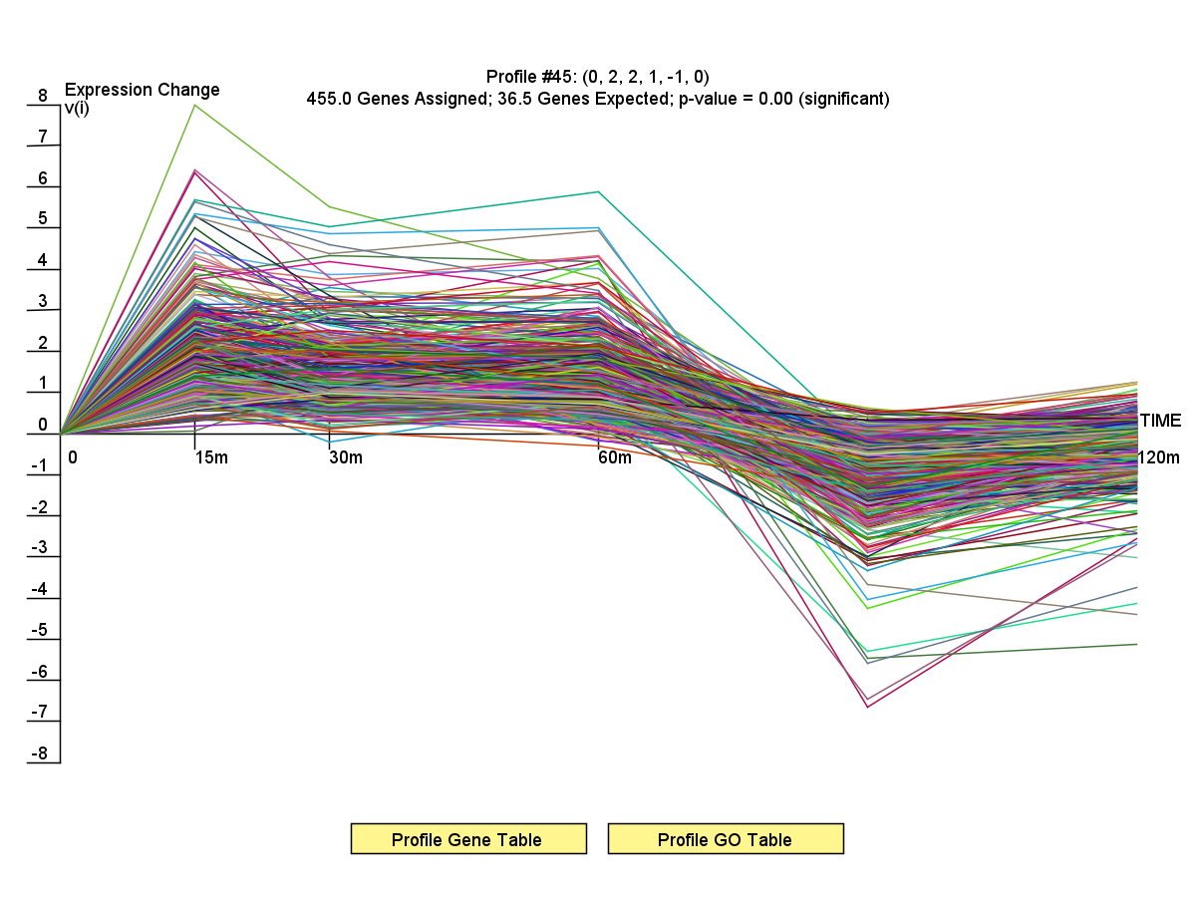
dCIN5 profile 45

Slide 3
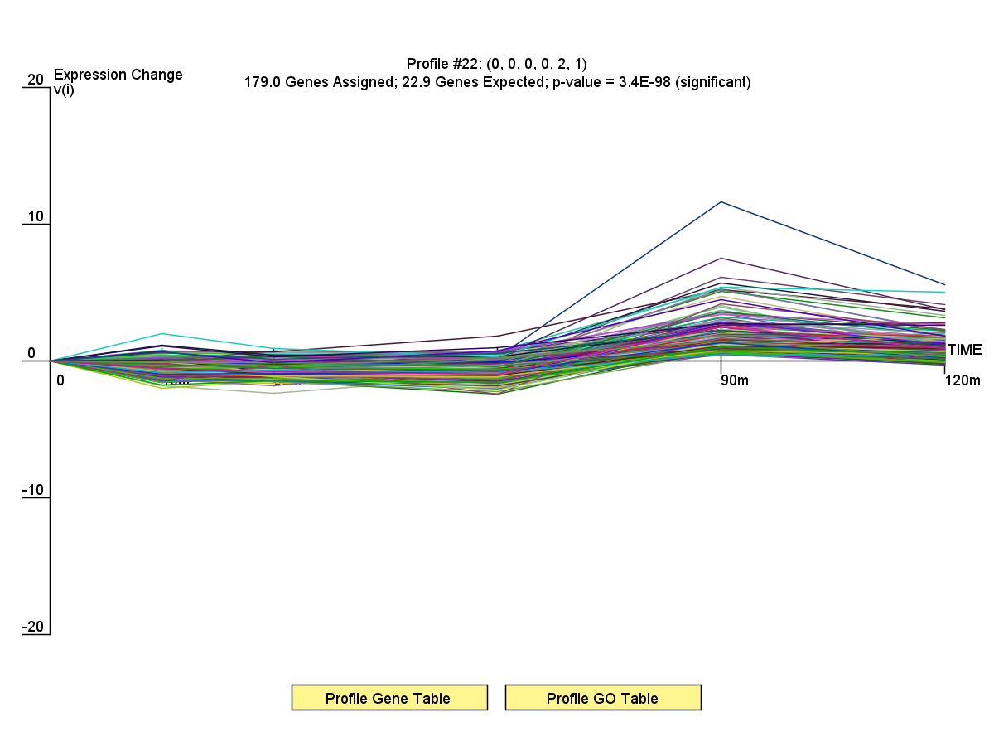
dCIN5 profile 22

Slide 4
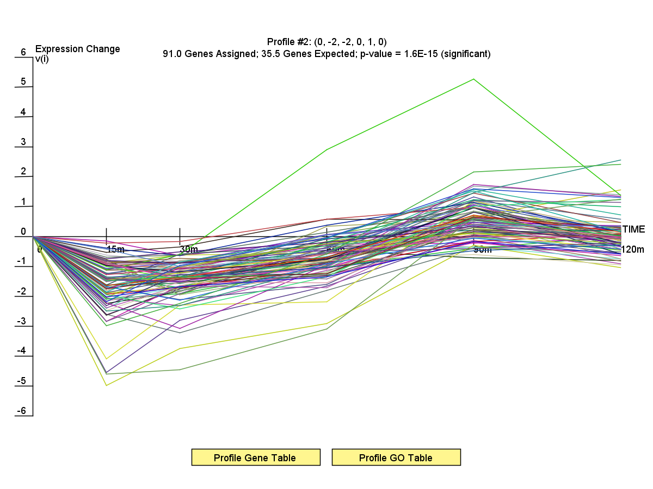
dCIN5 profile 2

Slide 5
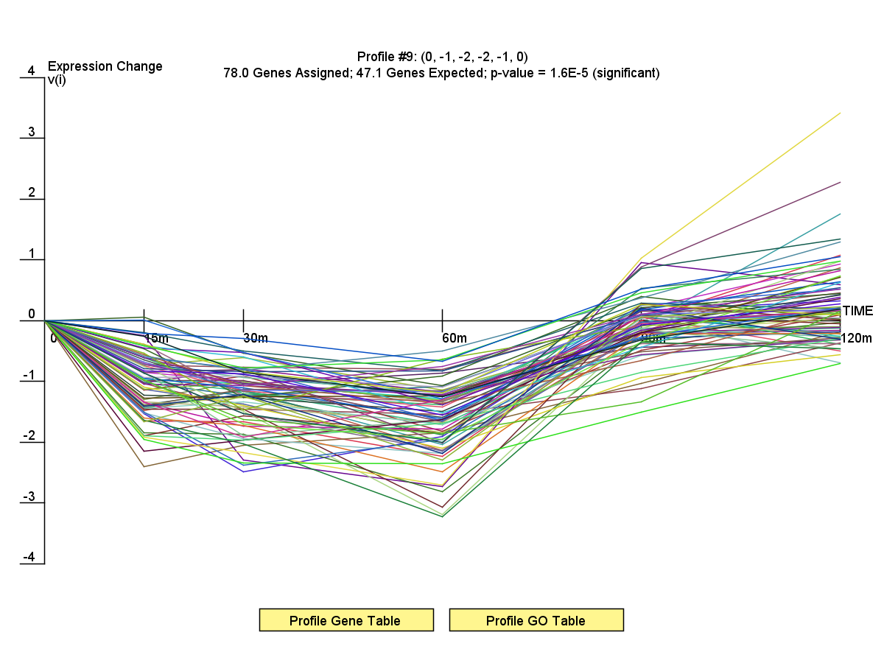
dCIN5 profile 9

Slide 6
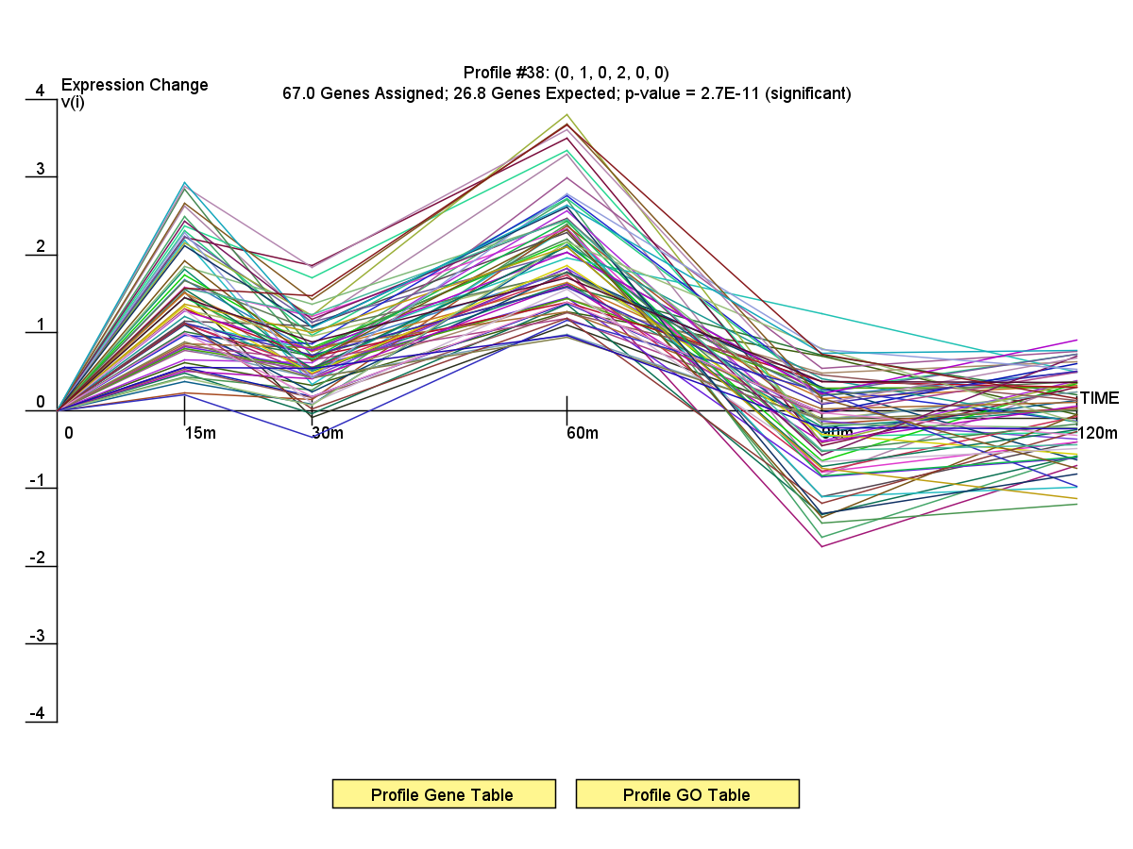
dCIN5 profile 38

Slide 7
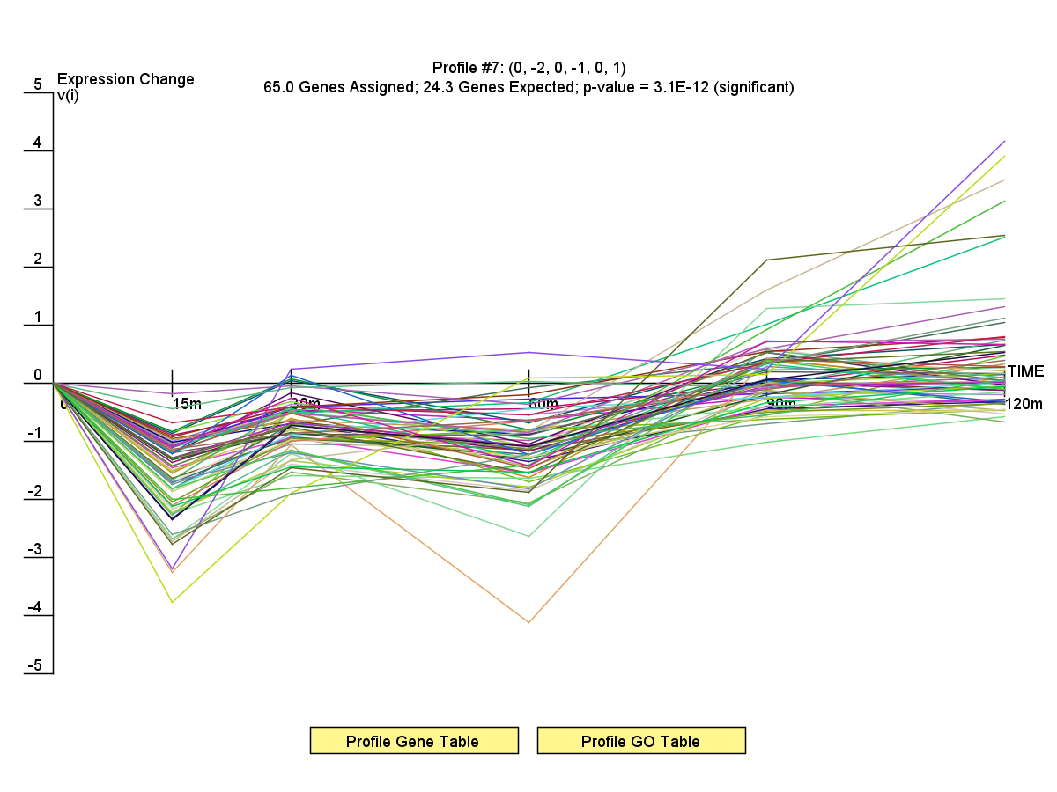
dCIN5 profile 7

Slide 8
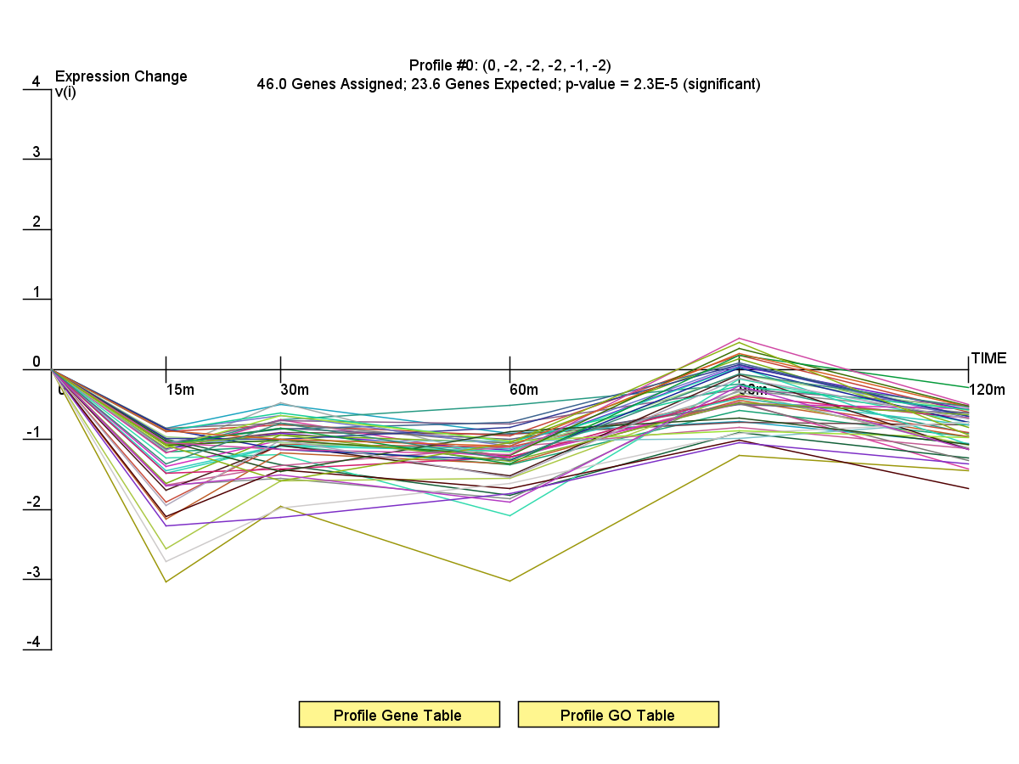
dCIN5 profile 0

